Slide 1
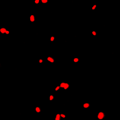
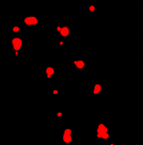
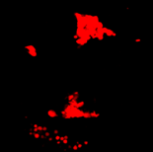
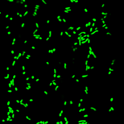
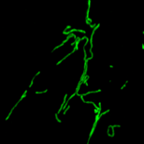
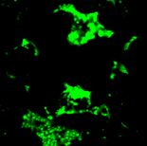
Col-0
pmd1
35S_{pro}:PMD1
Mitochondria (COX4-YFP) Peroxisomes (CFP-PTS1)
Fig. 1. Peroxisome and Mitochondrial Division 1 (PMD1) is a component of the peroxisome and mitochondrial division/proliferation machinery. Confocal images were taken from leaf epidermal cells of PMD1 loss-of-function mutant and overexpressor, showing abnormal morphologies of peroxisomes and mitochondria that are fluorescently labeled by organelle marker proteins CFP-PTS1 and COX4-YFP, respectively. Scale bar = 10 μm.

Slide 2
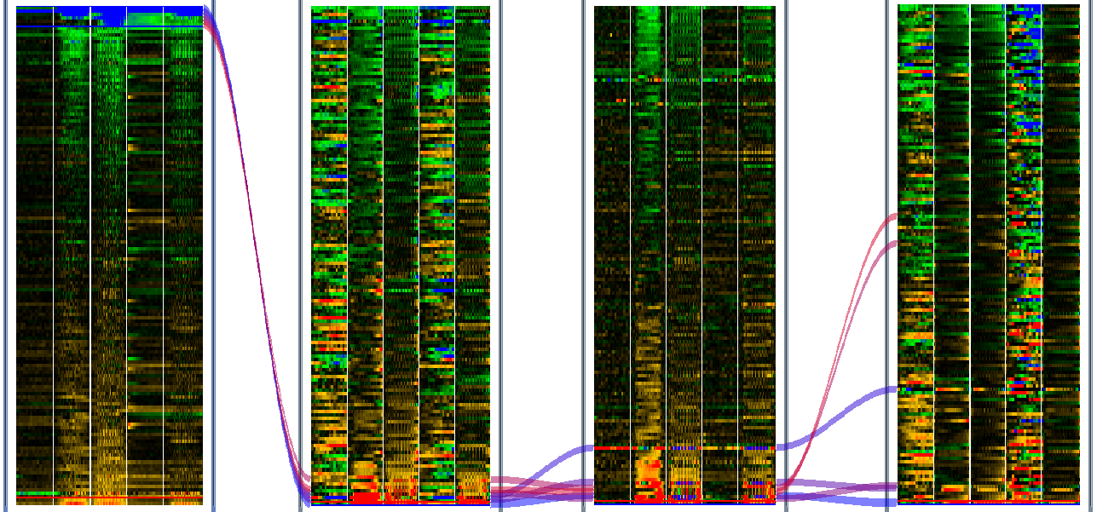
Φ2
NPQ
qE
qI
Peroxisome mutants
-1.6
1.6
-0.4
0.4
-0.3
0.3
-1.8
1.8
Fig. 2. Photosynthetic phenotypes were revealed in peroxisomal mutants under dynamic light conditions.
Shown are heatmaps of four photosynthetic parameters, Φ2, NPQ, qE and qI, in mutant relative to the WT. In each heatmap, x axis is time points, y axis is the ~150 peroxisomal mutants subjected to the screen, and the five columns represent five days of dynamic light treatment. The subgroup of mutants with lower Φ2 is indicated by the black box, and mutants in this subgroup are linked to each other between the heatmaps by curved lines. Color code is under each heatmap to indicate the level of changes.

